Slide 1


Detecting AI-Edited Images via Artifact Fingerprinting
Presented By:
Abdullah Irshad (CS-345)
Zeeshan Sarfraz (CS-370)
Sehar Farman (CS-375)
Taha Shahid (CS-378)

Slide 2
Introduction: The Rise of AI-Edited Images
1
2
3
Widespread Image Sharing
Easy AI Editing
Human Detection Fails
Images are shared daily across social media platforms like Facebook, Instagram, and WhatsApp.
AI tools allow anyone to edit or generate images in seconds, increasing fake content.
Most AI edits appear real to the human eye, making manual detection difficult.
4
5
Eroding Digital Trust
Automated Detection Need
The proliferation of fake images is causing a decline in trust for online content.
Manual checks are insufficient; automated systems are crucial for detection.

Slide 3

What is an AI-Edited Image?
An AI-edited image is one modified using advanced AI algorithms. The editing process is automated by software, requiring no manual photo editing.
AI predicts and changes pixels, resulting in realistic outputs that are often difficult to identify visually. This technology is common in modern applications.

Slide 4
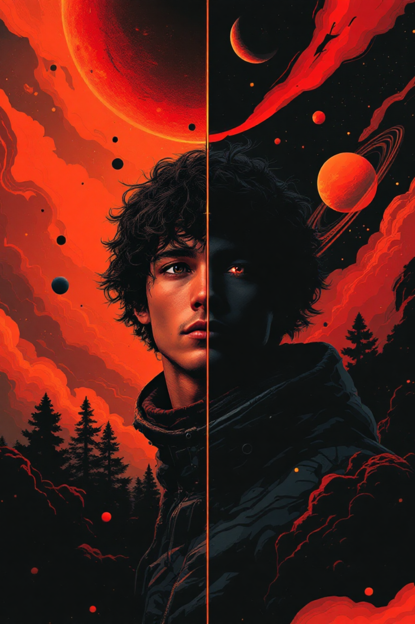
Real vs. AI-Edited Images
Real Images
AI-Generated Images
Captured by cameras, real images possess natural noise patterns.
Computer-generated, AI images exhibit artificial, subtle patterns.
Detection Challenge
These differences are often too subtle for humans, but machines can analyze them effectively.

Slide 5






Common AI Image Editing Tools
These tools range from advanced photo editors to dedicated image generators,
making AI-driven image manipulation accessible to all.

Slide 6


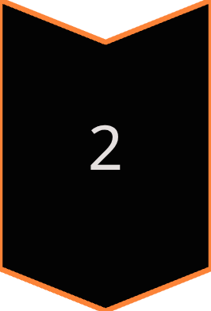

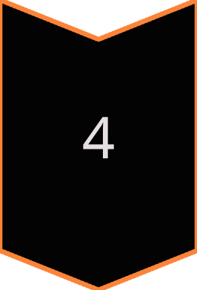
Artifact Fingerprinting: The Basic Idea
AI Tools Leave Traces
Every AI tool leaves unique digital traces, known as artifacts.
Artifacts as Fingerprints
These artifacts act like unique fingerprints, consistent for each AI model.
Pattern Recognition
Models can learn these consistent patterns for identification.
Diverse Artifact Types
Artifacts include noise patterns, distortions, and other subtle indicators.

Slide 7
Challenges in Detection
Realistic AI Images
1
AI-generated images are highly realistic, making visual detection difficult.
Evolving Tools
2
Editing tools evolve rapidly, constantly introducing new artifacts.
Lack of Visible Signs
3
Often, there are no obvious visual cues for human observers.
Data & Computation
4
Requires large datasets and high computational power for effective analysis.
Continuous Updates
5
Detection systems need continuous updates to keep pace with new AI developments.

Slide 8

Our Project: A Solution for Detection
Our project aims to develop a robust system for detecting AI-edited images by leveraging artifact fingerprinting. We focus on identifying the subtle, unique traces left by various AI tools.

Slide 9

Dataset Overview
47,946
11,665
52GB
Training Images
Test Images
Total Data
24,000 AI + 23,946 Real images for training.
5,665 AI + 6,000 Real images for testing.
A substantial dataset for comprehensive analysis.
Balanced classes with an approximate 50/50 split.
Diverse sources from multiple AI generation tools.
Images resized to 380x380 and colors normalized during preprocessing.

Slide 10

Preprocessing Steps
01
Image Resizing
All images are uniformly resized to 380x380 pixels.
02
Pixel Normalization
Pixel values are normalized to ensure consistent data input.
03
Corrupted Image Handling
Robust error handling skips corrupted or truncated files.
04
Analysis Preparation
These steps prepare the dataset for accurate and efficient analysis.

Slide 11

How Does It Work? Detecting AI Artifacts
Supervised Deep Learning
Model Type
Convolutional Neural Network
Detects AI artifacts invisible to humans:
- Texture inconsistencies
- Frequency-domain irregularities
- Compression patterns
Our system employs a supervised deep learning approach, leveraging a specialized Convolutional Neural Network (CNN) to identify subtle indicators of AI-generated content.
Pattern Recognition
The model learns to distinguish between authentic and AI-generated images by analyzing thousands of examples, enabling highly accurate Binary Classification: AI vs. Real.

Slide 12





Model Architecture: Precision and Efficiency
Our CNN model is meticulously designed for optimal accuracy and computational efficiency, processing high-resolution inputs to deliver reliable classifications.
Input Layer
Receives a 380 × 380 × 3 image, translating to 433,800 pixel values for detailed analysis.
Middle Layers
These layers are responsible for extracting complex visual patterns such as edges, textures, and shapes that are crucial for detection.
Feature Vector
The extracted patterns are compressed into a 1,792-number feature vector, representing the most salient characteristics of the image.
Output Layer
Makes the final binary decision: classifying the input image as either AI-generated or Real.
With approximately 19 million parameters, the model balances complexity with performance, ensuring robust detection capabilities.

Slide 13
Simplified Explanation: Machine Learning Core
01
02
03
Convolutional Neural Network (CNN)
Artifact Pattern Learning
Dataset Training
Through extensive training, the CNN learns to identify subtle patterns and 'artifacts' that are characteristic of AI-generated imagery.
The model is trained on a diverse dataset comprising both real and AI-generated images, enabling it to learn distinguishing features.
The model utilizes a CNN
04
05
06
Iterative Improvement
Complex Feature Handling
Binary Classification
Its performance continuously improves through iterative training cycles, where it refines its ability to detect AI artifacts.
The CNN excels at recognizing and processing complex visual features, which are often indicative of synthetic content.
Ultimately, the model performs a binary classification, categorizing each image as either AI or real.
07
Prediction Output
The output is a clear prediction, indicating the likelihood of an image being AI-generated.

Slide 14
Simplified Explanation: Training Phase
1
Labeled Image Input
During the training phase, the model is fed a curated dataset of images, each accurately labeled as either "AI" or "Real."
2
Learning Distinctions
The model's primary objective is to learn the subtle and overt differences between these labeled examples.
3
Weight Adjustment
Based on its predictions, the model iteratively adjusts its internal parameters (weights) to minimize prediction errors.
4
Error Reduction
This iterative adjustment process is designed to progressively reduce the discrepancy between the model's output and the true labels.
5
Accuracy Enhancement
Each adjustment refines the model's understanding, leading to a significant improvement in overall prediction accuracy.
6
Multiple Epochs
The training process involves multiple 'epochs,' where the entire dataset is passed forward and backward through the neural network several times.
7
Training Completion
Training is completed when the model achieves a satisfactory level of accuracy and generalization across the dataset.

Slide 15

Training Configuration: Optimal Setup
Our model's training configuration is fine-tuned to achieve optimal performance and robust learning, utilizing industry-standard practices and parameters.
Batch Size: 64
Epochs: 20
This batch size ensures efficient memory usage while providing a good gradient estimate for stable training.
Twenty full passes over the training dataset allows the model to learn complex patterns without overfitting.
Optimizer: AdamW
Learning Rate: 0.0001
AdamW is chosen for its adaptive learning rate capabilities and robust performance in deep learning tasks.
A conservative learning rate prevents divergence and allows the model to converge effectively.
Loss Function: Cross-Entropy
Training Time: ~12-14 Hours
Cross-Entropy loss is ideal for binary classification problems, measuring the performance of a classification model.
The total training duration reflects the complexity of the model and the size of the dataset.

Slide 16



System Used: Powering the Detection
Our development and training environment is built on a robust hardware and software stack, ensuring efficient model development and deployment.
Hardware Specifications
Software Environment
GPU: NVIDIA RTX 3090 (24GB VRAM)
Programming Language: Python 3.12, the latest stable version
RAM: 32GB DDR4
CPU: Intel i9 10850K
Deep Learning Framework: PyTorch 2.6.0, for flexible and efficient tensor computation
Storage: Approximately 54GB total for models and datasets
Operating System: Windows 11, providing a familiar and powerful development platform

Slide 17
Challenges & Solutions: Overcoming Obstacles
Image Size Optimization
1
Challenge: Determining the optimal input image size for artifact preservation and computational efficiency.
Solution: Extensively tested various input sizes (32×32, 128×128, 380×380). Identified that 32x32 was too small to capture crucial AI artifacts, leading to the selection of 380x380 for balanced performance.
2
Corrupted Images
Challenge: Handling corrupted or malformed image files within large datasets.
Solution: Implemented robust error handling mechanisms in the data loading pipeline to automatically skip corrupted files without interrupting training.
GPU Memory Limits
3
Challenge: Managing and optimizing GPU memory usage, especially with high-resolution inputs and complex models.
Solution: Strategically adjusted batch sizes, reducing GPU memory consumption by approximately 50% without significant performance degradation.
4
Training Interruptions
Challenge: Ensuring resilience against unexpected training interruptions or system failures.
Windows Multiprocessing
5
Solution: Integrated a checkpoint resume capability, allowing training to seamlessly continue from the last saved state.
Challenge: Addressing performance bottlenecks related to multiprocessing in a Windows environment.
Solution: Optimized DataLoader worker configurations specifically for Windows, enhancing data loading efficiency.
6
JPEG Compression
Challenge: Assessing the model's robustness to varying levels of JPEG compression, a common image manipulation.
Solution: Conducted thorough robustness testing against different JPEG quality settings (e.g., Q=70), documenting the observed accuracy drop to quantify limitations.

Slide 18
Understanding Key Performance Metrics
To comprehensively evaluate our model's effectiveness, we analyze a suite of standard classification metrics.
True Positive (TP)
True Negative (TN)
Correctly identified as AI when it is, in fact, AI.
Correctly identified as Real when it is, in fact, Real.
False Positive (FP)
False Negative (FN)
Incorrectly flagged as AI when it is actually Real (Type I error).
Missed AI, incorrectly classified as Real (Type II error).
Accuracy
Precision
(TP + TN) / Total: Overall correctness of the model.
TP / (TP + FP): Proportion of positive identifications that were actually correct.
Recall (TPR)
Specificity (TNR)
TP / (TP + FN): Proportion of actual positives that were correctly identified.
TN / (TN + FP): Proportion of actual negatives that were correctly identified.
F1 Score
AUC
2 × (Precision × Recall) / (Precision + Recall): Harmonic mean of Precision and Recall.
Area Under ROC Curve: Measures the model's ability to distinguish between classes.

Slide 19

Confusion Matrix Results: Test Dataset Performance
The confusion matrix provides a detailed breakdown of our model's classification performance on a test set of 11,665 images, illustrating its ability to correctly identify both AI and real images.
5517
5691
True Positives (TP)
True Negatives (TN)
Images correctly identified as AI-generated.
Images correctly identified as real.
309
148
False Positives (FP)
False Negatives (FN)
Real images incorrectly classified as AI-generated.
AI-generated images incorrectly classified as real.
With a total of 11,665 test images, these results demonstrate the model's strong performance with a relatively low number of misclassifications.

Slide 20
Performance Results: Comprehensive Evaluation
Our model demonstrates exceptional performance across a range of critical metrics, affirming its reliability in detecting AI-generated content.
96.08%
94.70%
97.39%
Accuracy
Precision
Recall (TPR)
Overall correctness in classification.
Accuracy of positive predictions.
Ability to find all positive samples.
94.85%
96.02%
5.15%
Specificity (TNR)
F1 Score
False Positive Rate
Ability to find all negative samples.
Harmonic mean of precision and recall.
Rate of real images misclassified as AI.
97.47%
3.92%
96.12%
NPV
Misclassification Rate
Balanced Accuracy
Accuracy of negative predictions.
Overall error rate of the model.
Average of recall and specificity.
Even with moderate JPEG compression (Q=70), the model maintains a strong accuracy of 88.67%,
indicating its robustness to common image degradations.
0.9220
0.9941
MCC
AUC
Matthews Correlation Coefficient.
Area Under the ROC Curve.

Slide 21
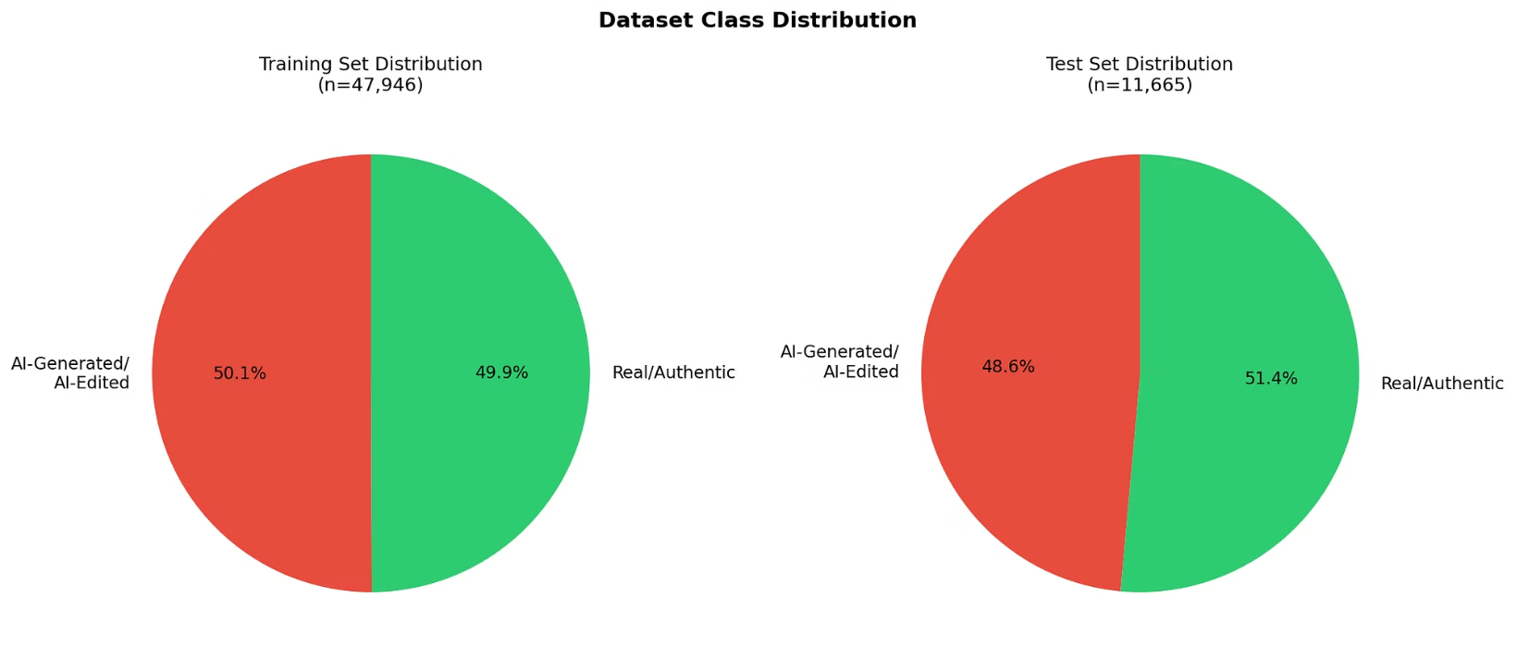
Data Class Distribution

Slide 22
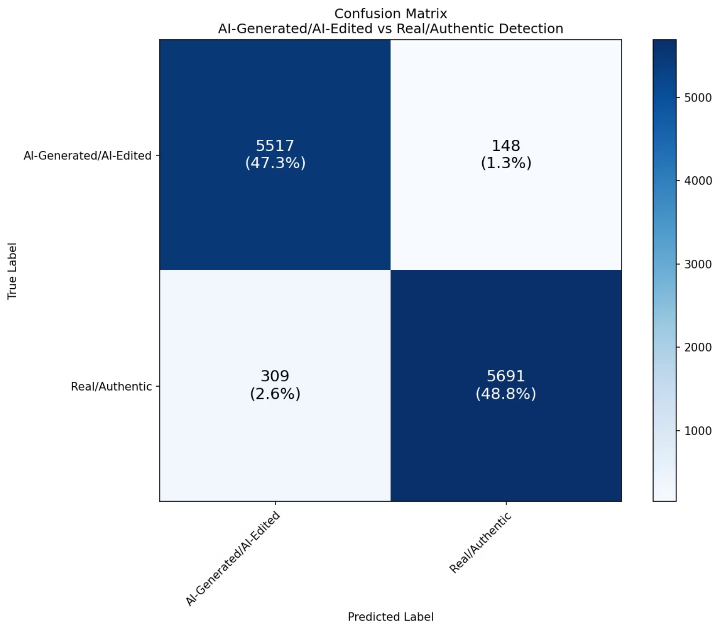
Confusion Matrix

Slide 23
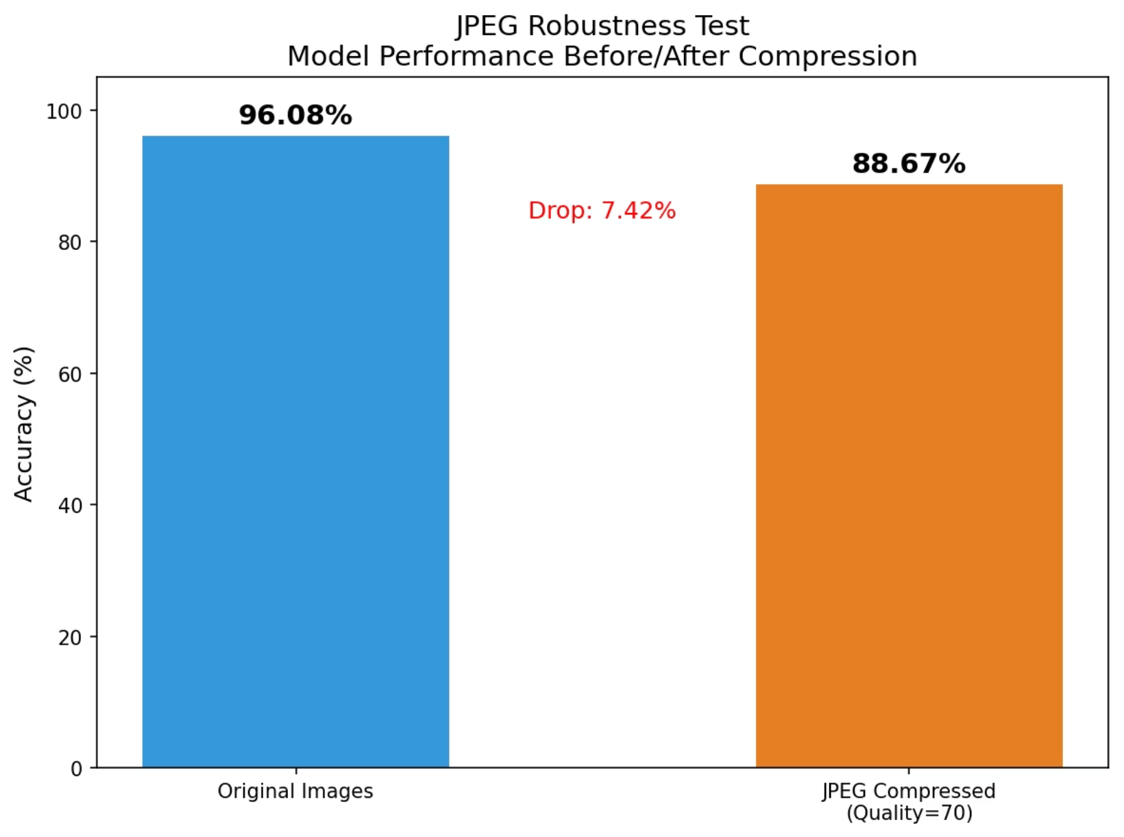
JPEG Robustness Test

Slide 24
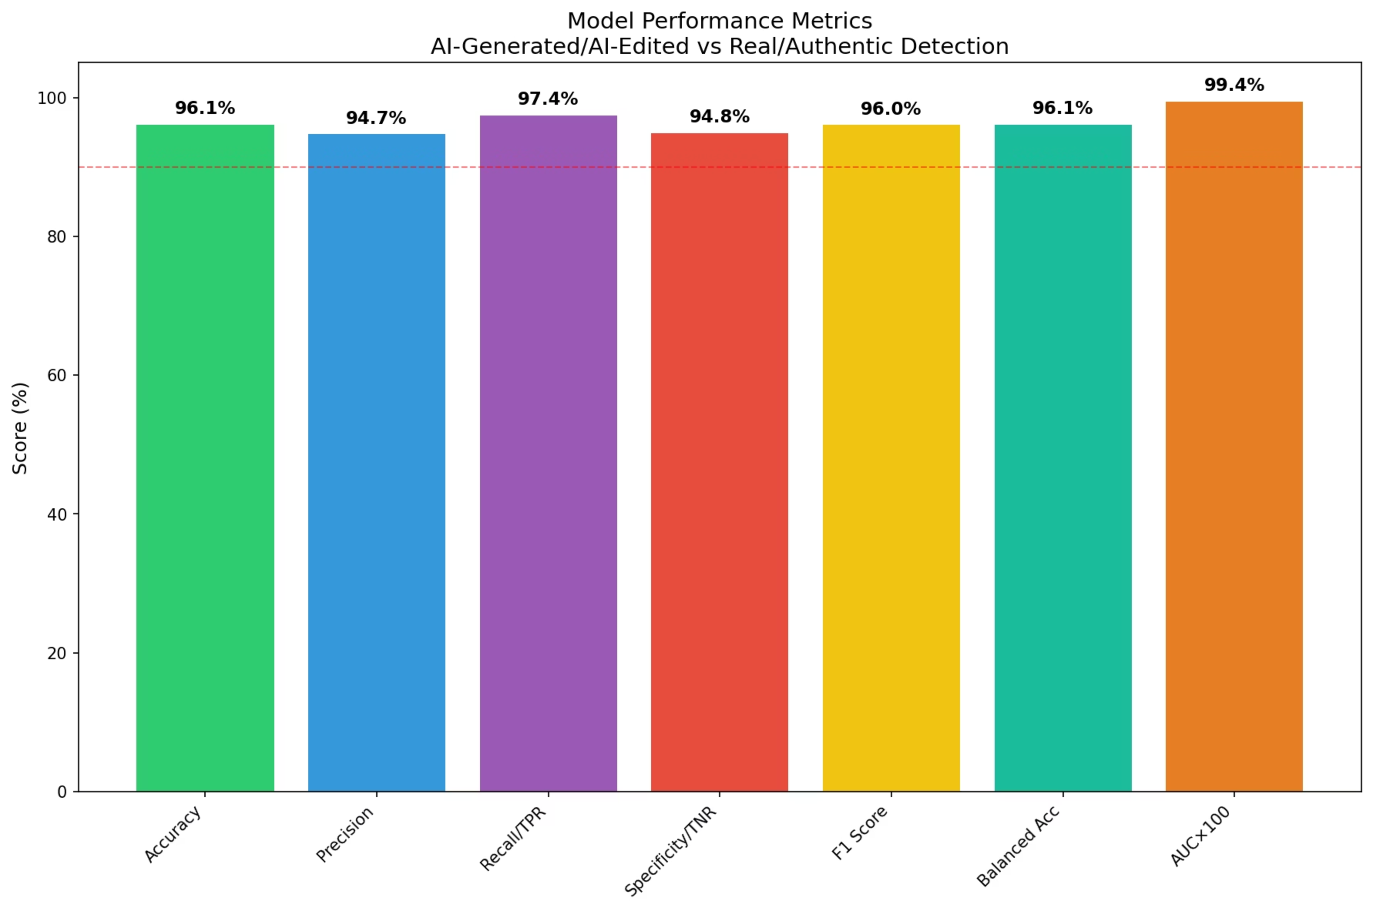
Model Performance Metrics

Slide 25
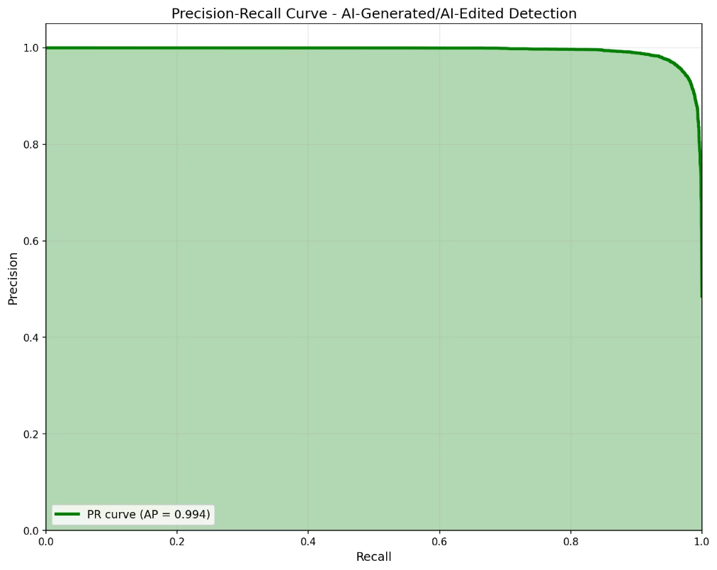
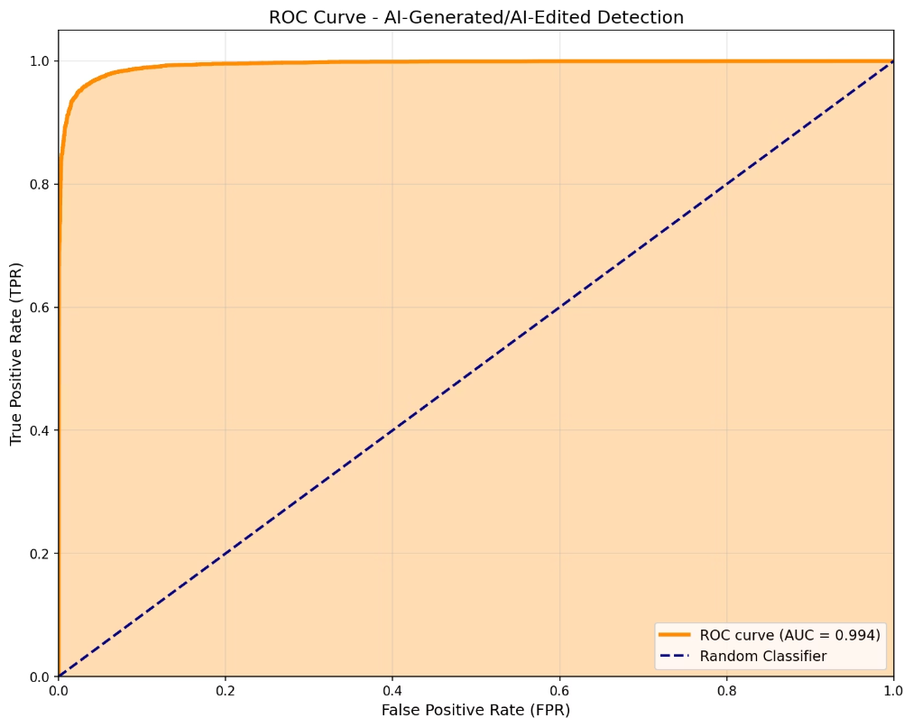
Precision-Recall Curve & ROC Curve

Slide 26
Current Limitations of the System
JPEG Compression Impact
Binary Classification
Future AI Methods
Performance can significantly drop with heavily compressed JPEG images (e.g., 88.67% reduction in accuracy at high compression).
The current system can only differentiate between real and AI-generated, not identify specific AI tools used.
New AI generation techniques may not be detected by the current model, requiring continuous updates.
Resolution Requirements
Partial Edits
A minimum resolution of approximately 100x100 pixels is needed for effective analysis.
The system performs full-image analysis and cannot yet pinpoint specific edited regions within an image.

Slide 27
Ethical Considerations
False Positives
User Privacy
Transparency
The system has a ~5% false positive rate, meaning it can sometimes wrongly flag real images as AI-generated.
Images should only be processed with explicit user consent to protect privacy rights.
Users must be fully informed about the system's limitations and potential inaccuracies.
Recommended usage guidelines:
Utilize as a screening tool, not a definitive verdict.
Always conduct human expert review for critical cases requiring absolute certainty.
Implement regular updates to adapt to new AI methods and improve detection capabilities.

Slide 28
Conclusion & Future Work
1
2
3
Achieved Results
Practical Application
Ethical Integration
We've achieved a promising 96.08% accuracy with a 0.9941 AUC, demonstrating high efficacy in current detection scenarios.
A user-friendly desktop GUI ensures easy and efficient testing for practical implementation.
We strongly recommend human review for critical decisions, balancing automation with human oversight.
4
5
Future Enhancements
Advanced Detection
Ongoing research includes JPEG augmentation for improved resilience and Grad-CAM visualization for interpretability.
Future work aims for multi-class detection to identify specific AI models used in image generation.

Slide 29

Thank You!
Questions?

